Slide 1
CSE 12 – Basic Data Structures and Object-Oriented Design Lecture 18
Greg Miranda, Spring 2021
This lecture is being recorded

Slide 2
Announcements
Quiz 18 due Wednesday @ 12pm
PA6 due Wednesday @ 11:59pm (open)
Survey 7 due Friday @ 11:59pm

Slide 3
Topics
Binary Search Trees
Questions on Lecture 18?

Slide 4
class Node<K,V> {
K key;
V value;
Node<K,V> left;
Node<K,V> right;
public Node(K key, V value,
Node<K,V> left,
Node<K,V> right) {
this.key = key;
this.value = value;
this.left = left;
this.right = right;
}
}
class BST<K, V> {
Node<K, V> root;
BST() (this.root = null);
BST(Node<K, V> root) { this.root = root; }
V get(Node<K, V> node, K key) {
if (node == null) { //throw error }
if (node.key.equals(key)) {
return node.value;
}
if (node.key > key) {
return get(node.left, key);
}
else {
return get(node.right, key);
}
}
V get(Key key) {
return this.get(root, key);
}
}

Slide 5
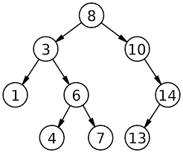
Binary Search Tree
Assume the key and value are identical for this example
Trace the path for get(4)
How many nodes does it touch?
Trace the path for get(2)
How many nodes does it touch?
What happens when the nodes isn’t found?

Slide 6
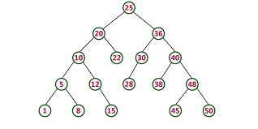
Binary Search Tree
Assume the key and value are identical for this example
Trace the path for get(40)
How many nodes does it touch?
Trace the path for get(4)
How many nodes does it touch?

